Slide 1
I.C. ENGINES

Slide 2
INTRODUCTION
I.C ENGINES:- It is a device which converts the chemical energy of fuel into thermal energy and then uses this energy to produce mechanical work.

Slide 3
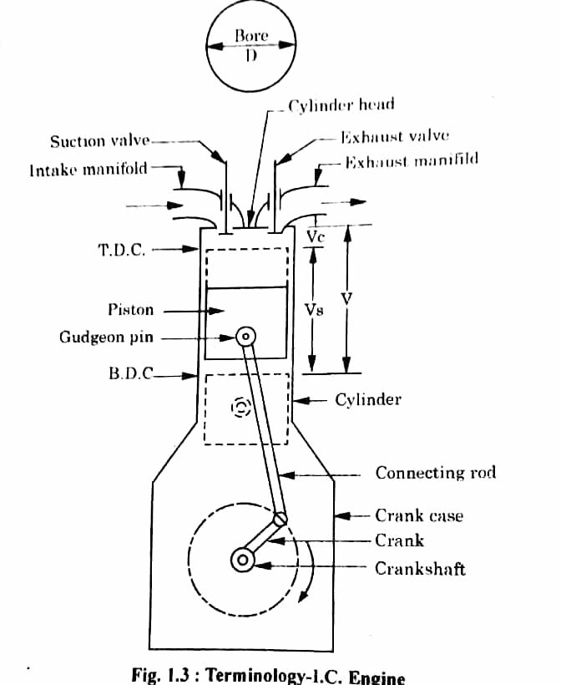
I.C.Engine Terms

Slide 4
I.C. ENGINES TERMS
Cylinder Bore
Piston Area
Dead Centre
Crank Radius
Displacement Volume
Clearance Volume
Compression Ratio
Piston Speed
Stroke

Slide 5
TYPES OF I.C. ENGINES
(a). External Combustion Engines:- The engine in which combustion of fuel take place outside the engine cylinder known as external combustion engine. E.g. steam engine , steam turbine (b).Internal Combustion Engine :-The engine in which the combustion of fuel take place inside the engine cylinder is known as internal combustion engine. E.g. Petrol engine , gas engine and diesel engine.

Slide 6
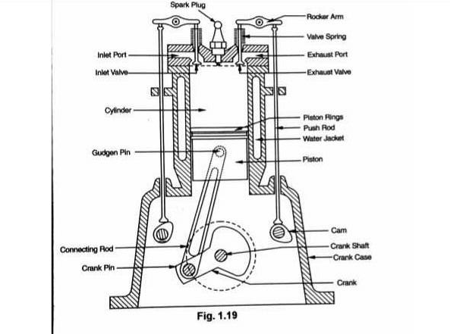
Cross Section Of Spark Ignition Engine

Slide 7
VARIOUS PARTS OF I.C. ENGINES
Cylinder
Cylinder Head
Piston
Piston Ring
Gudgeon Pin
Connecting Rod
Crank Shaft
Valves
Fly Wheel
Cam Shaft
Spark Plug
Carburettor
Fuel Injector
Fuel Injection Pump

Slide 8
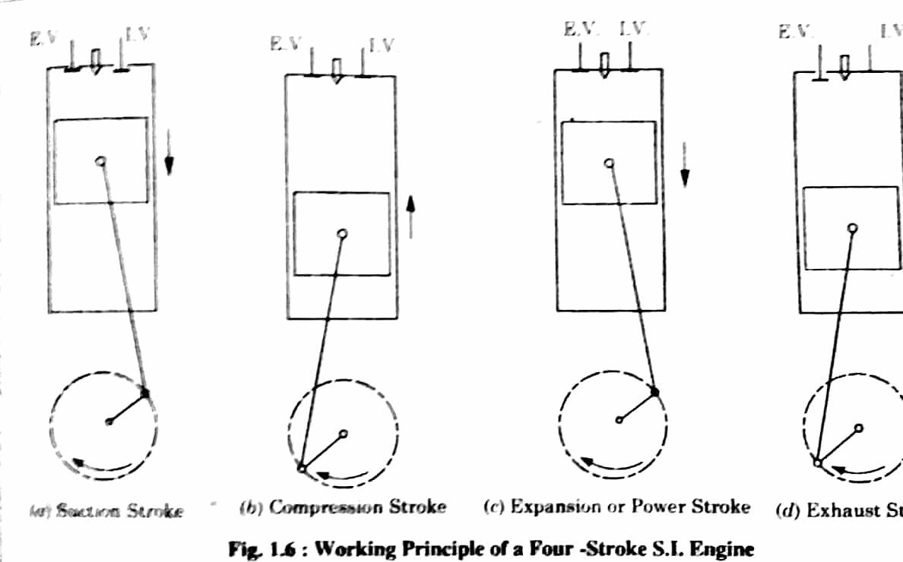
Four Stroke Petrol Engine

Slide 9
TYPES OF STROKE CYCLE ENGINES
1. Four stroke cycle engines:- The engine which requires four stroke of piston or two revolutions of the crank shaft to complete the working cycle is known as four stroke cycle engines. 2. Two stroke cycle engines:- The working cycle is complete in two stroke of piston in one revolution of the crankshaft.

Slide 10
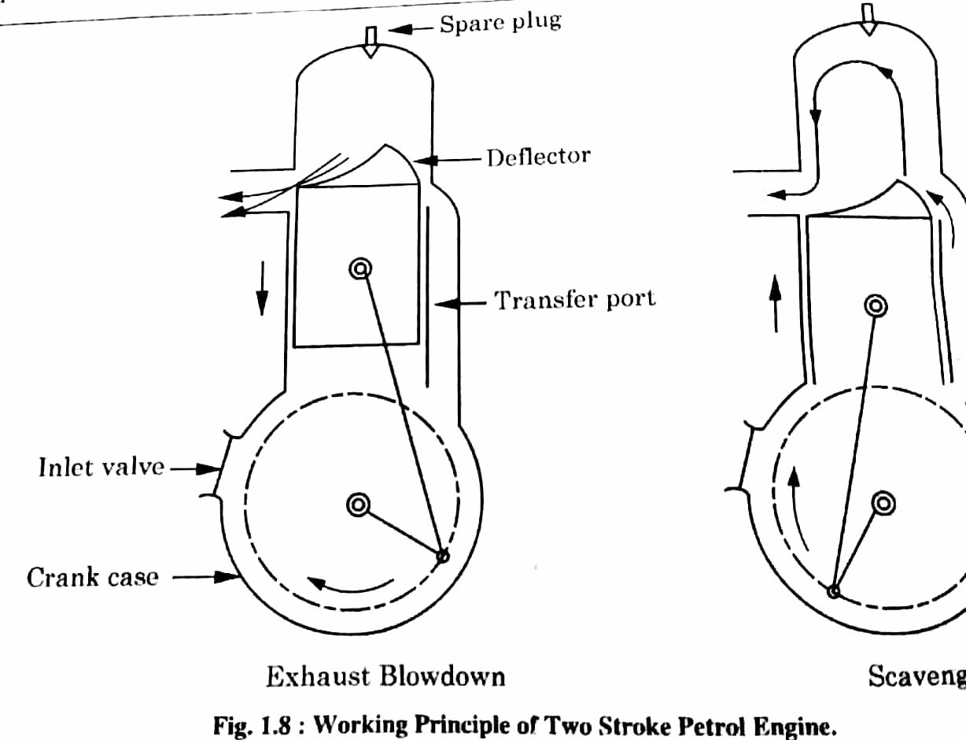
Two Stroke Petrol Engine

Slide 11
Diesel Cycle
The diesel cycle was developed by Rudolph Diesel with the aim to obtain higher thermal efficiency at higher compression ratio. This cycle consists of two adiabatic processes ,one constant pressure process and on constant volume process.

Slide 12
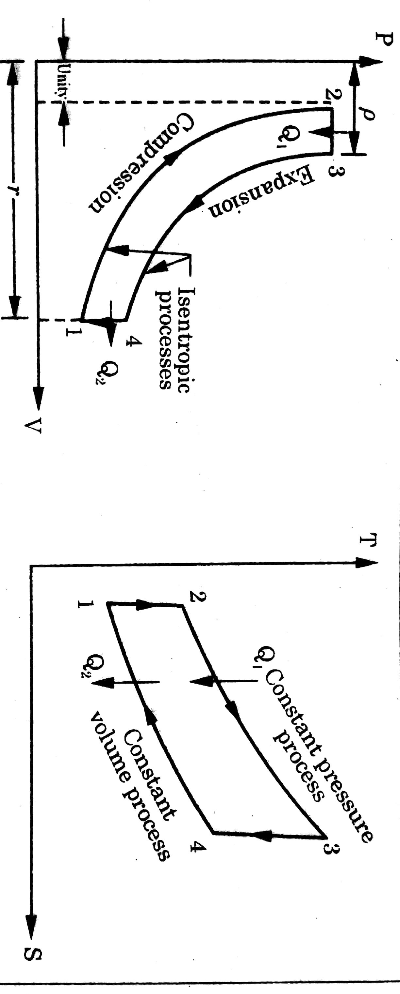
Diesel Cycle

Slide 13
Fuel Supply In Petrol Engine

Slide 14
Concept Of Carburetion
Carburetion: The process of breaking up and mixing of the fuel is called carburetion.
●To complete this process of Carburetion, the device provided is named as carburettor.
◆Vaporisation: It is the change of state of the liquid to vapour, whereas ‘atomisation’ is a mechanical breaking up of the liquid fuel into small particles, so that every particle of the fuel is surrounded by air.

Slide 15
Air fuel Ratio(A/F Ratio)
The ratio in which air is mixed with fuel for the purpose of combustion is called air fuel ratio.
Air and fuel are mixed to form three different types of mixture:-
Chemically correct mixture
Rich mixture
Lean mixture

Slide 16
Types of carburettors:-
Updraught type.
Downdraught type.
Horizontal type.

Slide 17
Mixture requirements at different conditions
These various requirements lf SI engine are as follow:-
1)Air fuel ratio during starting.
2)Air fuel ratio during economy running.
3)Air fuel ratio for power range.
4)Air fuel ratio during acceleration.
5)Air fuel ratio for maximum economy of fuel

Slide 18
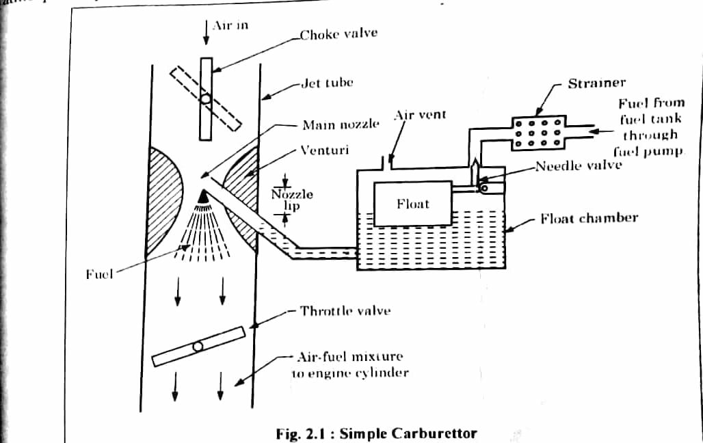
Simple Carburettor

Slide 19
Functions of carburettor
A carburettor should perform the following functions:-
1)Maintain a small reserve of petrol under a constant head.
2)Vaporise the liquid fuel by means of engine suction and to perform uniform mixture with the air.
3)Supply the correct mixture of air and fuel according to the load requirements of engine.
4) Provide rich mixture for starting of engine and during acceleration.

Slide 20
Applications of simple carburettor:-
The applications are:-
1)It is fitted on small stationary petrol engine to run at constant speed.
2)It is also fitted on small portable petrol engine for agriculture and horticulture sector.

Slide 21
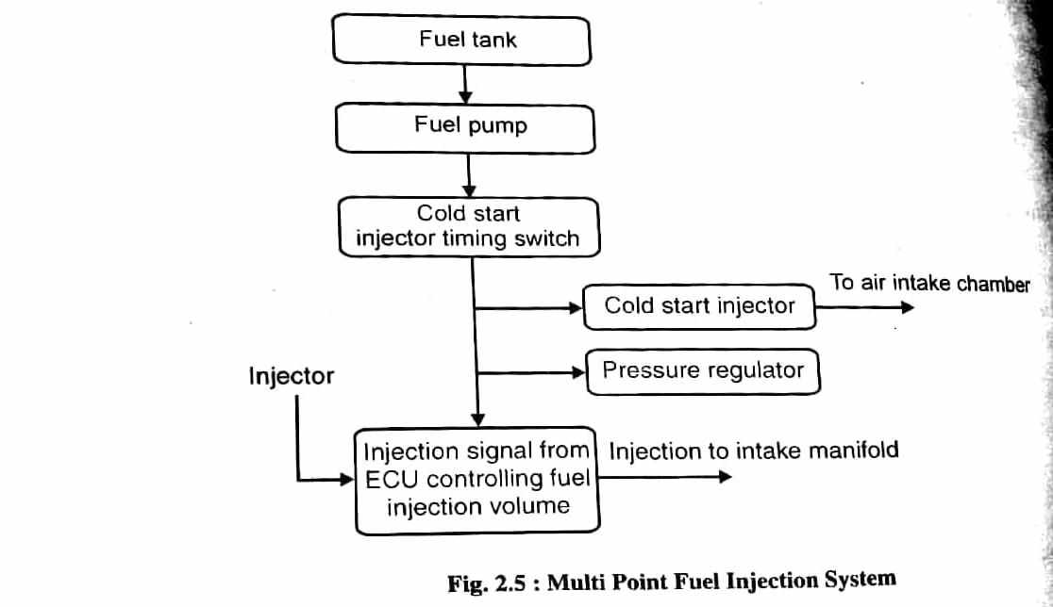
MPFI System

Slide 22
MPFI System:-
MPFI Stands for ‘Multi point fuel injection’.This system injects fuel into individual cylinders of the engine based upon commands obtained from’Engine Control Unit’
◆There are two types of fuel injection in MPFI System:-
1)Port Injection.
2) Throttle body Injection.

Slide 23
MPFI System:-
MPFI Stands for ‘Multi point fuel injection’.This system injects fuel into individual cylinders of the engine based upon commands obtained from’Engine Control Unit’
◆There are two types of fuel injection in MPFI System:-
1)Port Injection.
2) Throttle body Injection.

Slide 24
CH.3 FUEL SYSTEM OF DIESEL ENGINE

Slide 25
COMPONENTS OF A FUEL INJECTION SYSTEM
(1). FUEL TANK,
(2). FUEL FEED PUMP,
(3). FUEL INJECTION PUMP,
(4). FUEL INJECTOR,
(5). FUEL FILTER.

Slide 26
FUEL TANK
Fuel tank is used to store the fuel.

Slide 27
FUEL FEED PUMP
The purpose of the fuel feed pump is to supply the fuel from the fuel tank to the injection pump

Slide 28
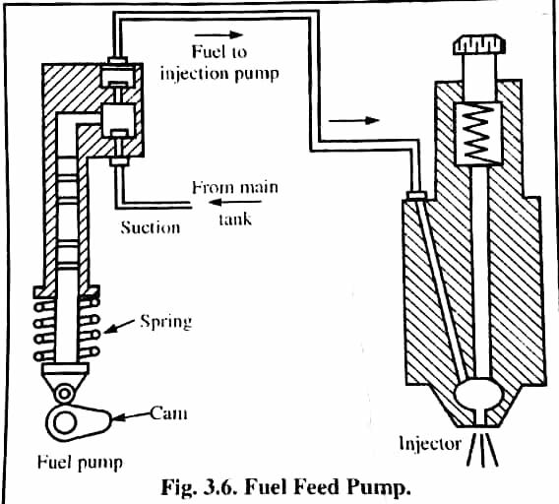
Fuel Feed Pump

Slide 29
FUEL INJECTION PUMP
The purpose of fuel injection pump is to meter the correct quantity of fuel and deliver it at the correct time to the engine cylinder according to the varying load and speed requirements.

Slide 30
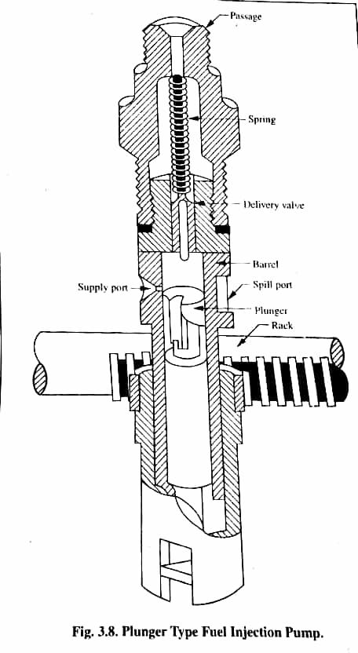
Plunger Type Fuel Injection

Slide 31
TYPES OF FUEL INJECTION PUMP
There are two types of fuel injection pumps:-
(1). Distribution type fuel injection pump
(2) Plunger type fuel injection pump

Slide 32
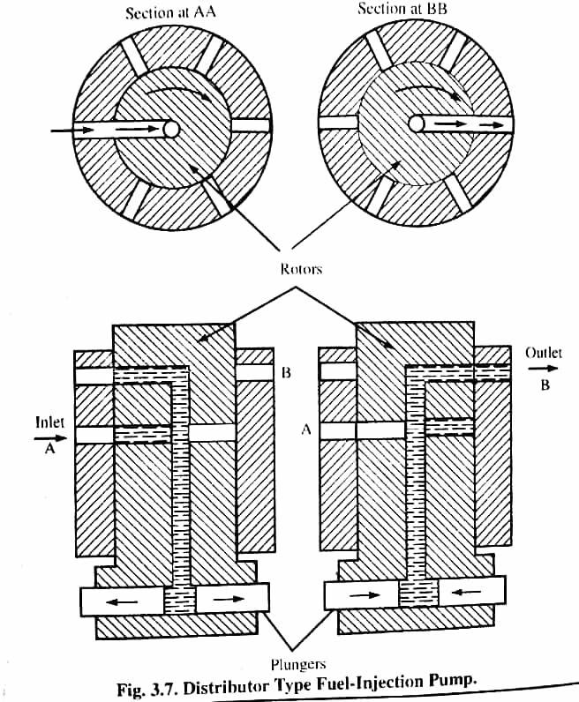
Distributor Type Fuel Injection System

Slide 33
FUEL INJECTOR OR ATOMISER
A nozzle mounted on the combustion chamber which supplies the fuel to the engine cylinder in the form of a fine spray is known as a fuel injector or atomizer or fuel valve or nozzle or sprayer.

Slide 34
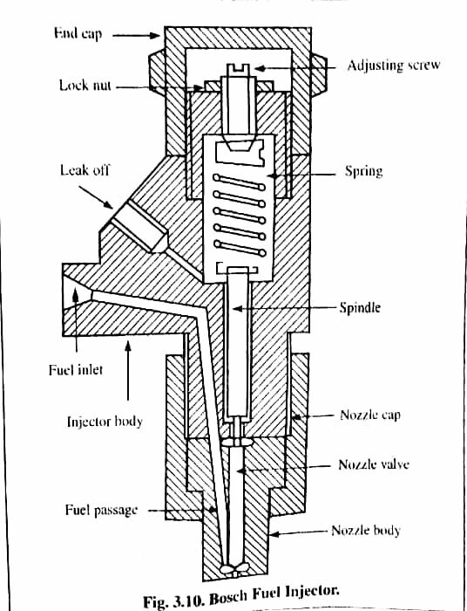
Fuel Injector Or Atomiser

Slide 35
COMPONENTS OF FUEL INJECTOR
(1). A NEEDLE VALVE,
(2). A COMPRESSION SPRING,
(3). A NOZZLE,
(4). AN INJECTOR BODY.

Slide 36
NOZZLE
Nozzle is that part of an injector through which the liquid fuel is sprayed into the combustion chamber.

Slide 37
TYPES OF NOZZLE
The usual types of injection nozzles are discussed below:-
(a) Single hole nozzle,
(b) Pintle nozzle,
(c) Multi-hole nozzle,
(d) Circumferential orifice nozzle,
(e) Pintaux nozzle.

Slide 38
(A) SINGLE HOLE NOZZLE
This is the simplest type of the nozzle. It consists of a single hole bored centrally through the nozzle body and closed by the needle valve.

Slide 39
(B) PINTLE NOZZLE
The stem of nozzle valve is extended to form a pin or pintle which ends through the mouth of the nozzle. T he size and shape of pintle can be varied according to requirement.

Slide 40
(C) MULTI-HOLE NOZZLE
It consists of a number of holes bored in the tip of the nozzle. This type of nozzle finds extensive use in automobile engines having open combustion chambers. The number of holes varies from 4 to 18

Slide 41
(D) CIRCUMFERENTIAL NOZZLE
The injected fuel particles tend to project in the form of plane with wide angle cone. The purpose of this is to obtain maximum possible area of fuel which comes into the contact with the air in the combustion chamber.

Slide 42
(E) PINTAUX NOZZLE
When an auxiliary hole is provided at the nose of a pintle nozzle, it is called pintaux nozzle. The auxiliary hole supplies fuel in the upstream direction during the idling or at the starting of the engine.

Slide 43
CH.4 IGNITION SYSTEM OF I.C. ENGINES

Slide 44
BATTERY IGNITION SYSTEM
Most of the modern spark ignition engines use this system. The required components of a battery ignition system are as follows:-
1.A battery of 6 to 12 volts,
2.Ignition switch,
3.Ignition coil with a ballast resistor,
4.Distributor,
5.Contact breaker,
6.Condenser,
7.Spark plug.

Slide 45
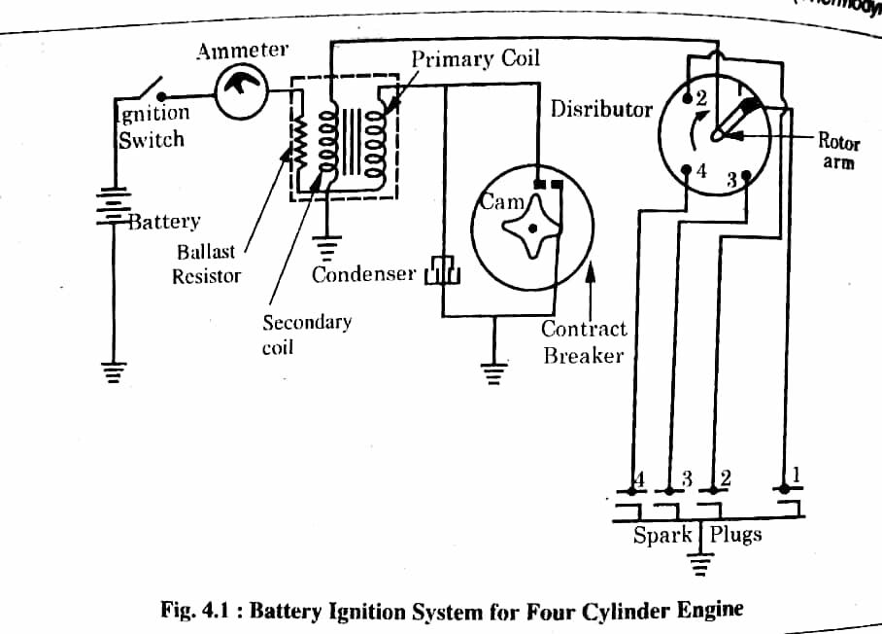
Battery Of Ignition System

Slide 46
OPERATION OF A BATTERY IGNITION SYSTEM
The primary ignition circuit starts from the battery and passes through the ignition switch, ammeter, primary winding and contact breaker points to the ground. A condenser is also connected in parallel to the contact breaker points. One end of the condenser is ground and the other end is connected to the contact breaker arm.
The secondary ignition circuit starts from the ground and passes through the secondary winding, distributor and spark plugs to the ground. It is not connected with the primary ignition circuit.

Slide 47
ADVANTAGES
It provides a good spark at low speeds.
It is cheap.
Maintenance cost is very less except the cost of battery.
It can be used easily on buses and cars.

Slide 48
LIMITATIONS
The primary voltage decreases as the engine speed increases.
Maintenance cost of battery is high.
The engine cannot be started if the battery is discharged.

Slide 49
MAGNETO IGNITION SYSTEM
The principle of magneto ignition system is similar to battery ignition system except that the magnetic field in the core of primary and secondary winding is produced by a rotating magnet. As the magnet rotates, the magnetic field is produced in the coils. Magnetic flux varies from a positive maximum to negative maximum and vice-versa.the fast variation of magnetic field induces a current in the primary winding of coil. But this fast variation of field is not enough to induce high voltage required for sparking. Therefore, for rapid breakdown of magnetic flux, the breaker points and the condenser are provided in the circuit as in case of battery ignition system.

Slide 50
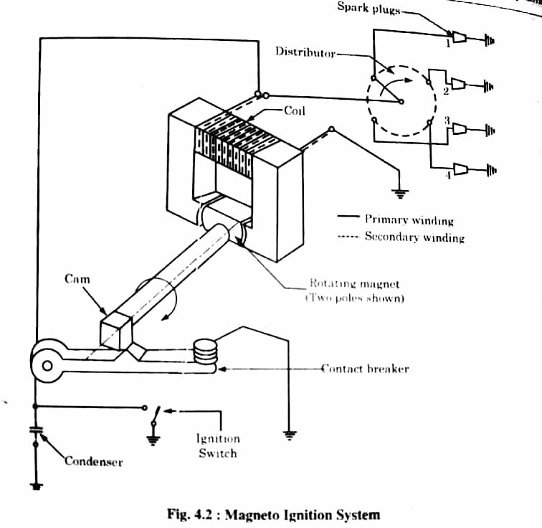
Magneto Ignition System

Slide 51
ADVANTAGES
It is best for high speed vehicles.
It is less expensive.
This system is favoured for two wheelers due to light weight and low maintenance.

Slide 52
DISADVANTAGES
Since the wiring carries a very high voltage, therefore, thus there is a strong possibilityof causing engine misfire due to leakage.
To avoid above problem, the high tension wires need suitable shielding.
At low speeds, it develops poor quality of spark at the time of starting.

Slide 53
APPLICATIONS
It is used in racing cars.
It is preferred for two wheelers.

